Slide 1
Xamarin@FooCafé
2014-05-22

Slide 2
Agenda
Key challenges with cross-platform development
Different cross-platform techniques
About Xamarin
Xamarin Environment
Code sharing techniques
Xamarin in Visual Studio
Demo

Slide 3
Key challenges with cross-platform
No customer wants to pay for 2-3 major apps
What happens with Windows Phone in 3 years?
Which cross-platform solution is still available in 3 years?
Sharing UI design or Native UX?
Native-quality UI performance?
Higher requirements in LOB with security, offline support etc.
BYOD

Slide 4
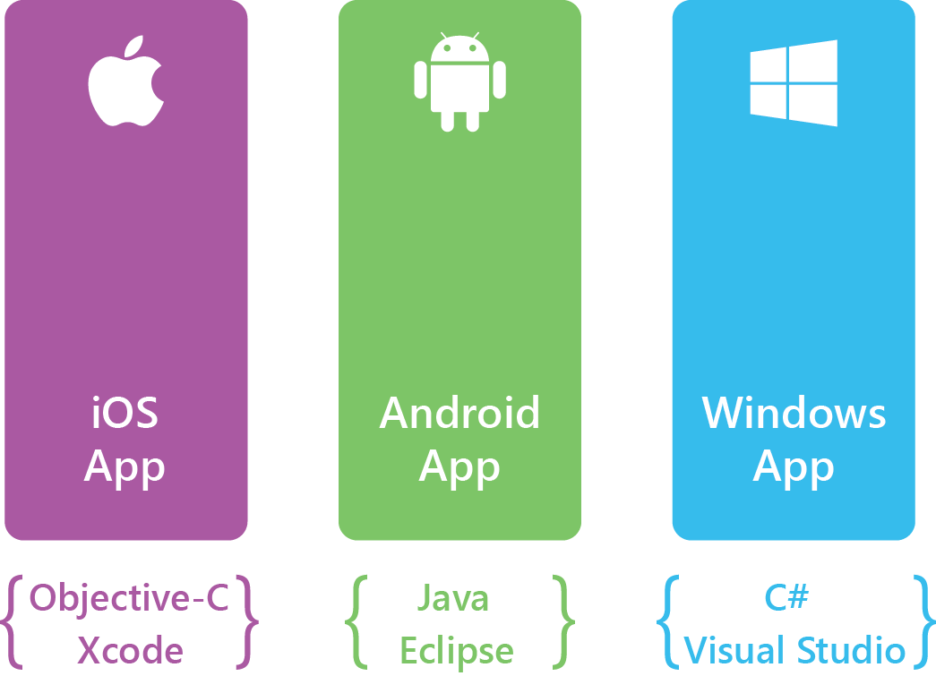
Silo approach, build apps multiple times

Slide 5
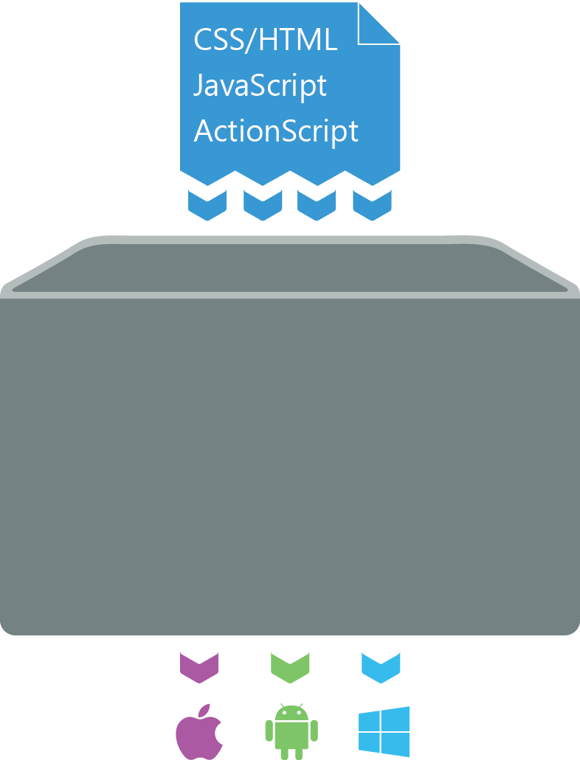
Write once, run anywhere approach
Appcelerator Titanium
FireMonkey
Cordova (Phonegap)
Sencha
etc.

Slide 6
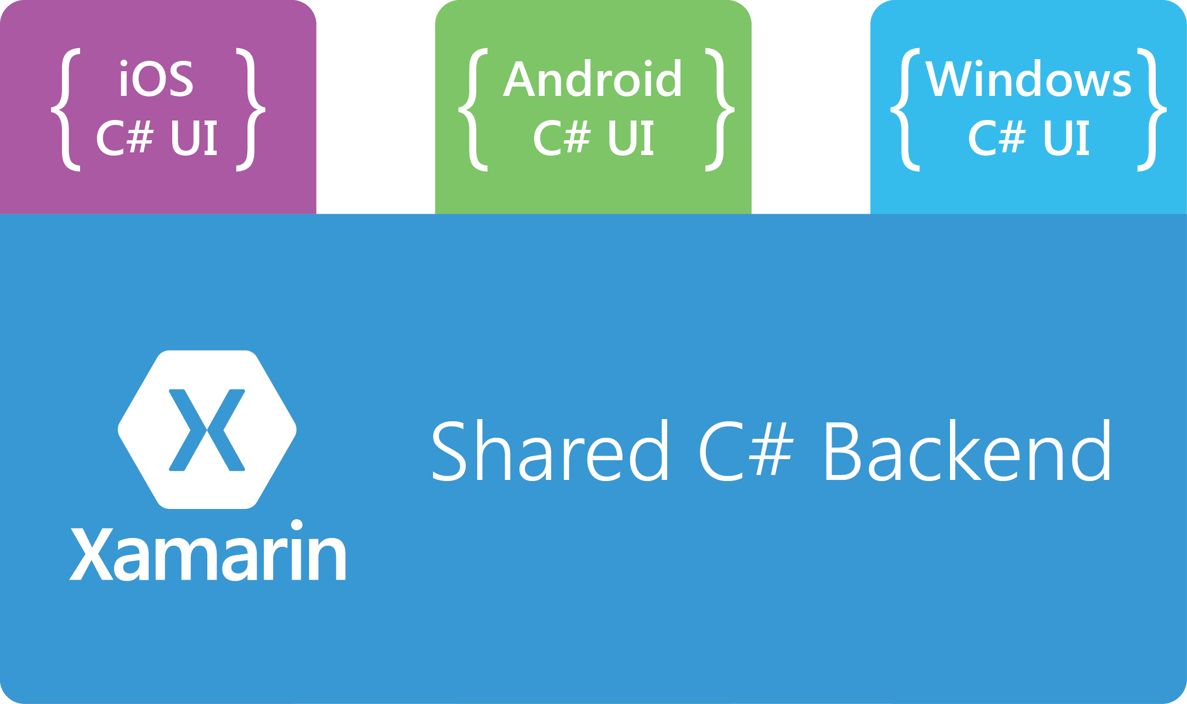
Xamarin approach

Slide 7
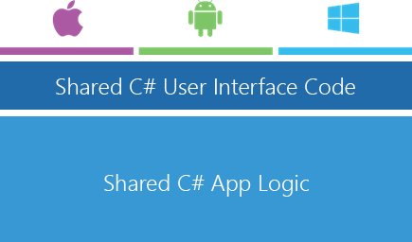
Xamarin.Forms – The ”new” approach

Slide 8
About Xamarin
History
.NET 2000
Miguel De Icaza, Mono 2001 (Ximian)
Novell 2003
Xamarin 2011
Xamarin Studio (MonoDevelop)
Xamarin.iOS (MonoTouch), Xamarin.Android (Mono for Android), Xamarin.Mac
Mono – Open source, C# .NET

Slide 9
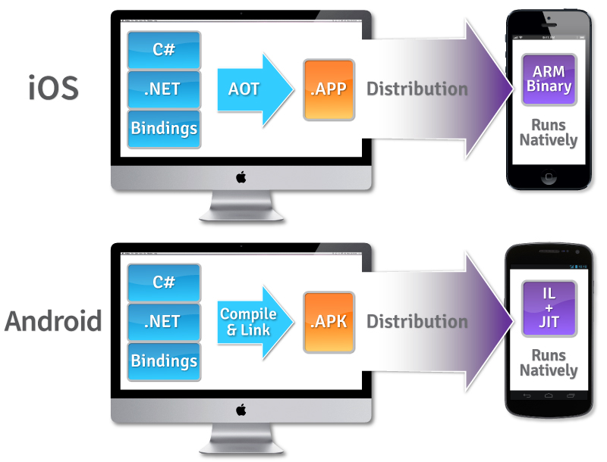
How it works…
C# + .NET Runtime
Native UI
Native Performance
Native Compilation
iOS -> AOT -> ARM
Android -> JIT

Slide 10
Why use Xamarin?
C# - Constantly evolving
“The new Microsoft” is obsessed with cross-platform/open source
.NET released as open source last month (build)
Xamarin tightly integrated with Microsoft release process for .NET – all new releases of .NET are tested on Mono
High performance
Native UI
Xamarin Test Cloud
Visual Studio
Nuget support in Xamarin Studio
500,000+ developers
Component Store

Slide 11
Xamarin.Mobile
Single set of APIs for accessing common mobile device functionality across iOS, Android, and Windows platforms
Abstraction over Contacts, camera, and geo-location APIs across iOS, Android and Windows platforms
Future plans include notifications and accelerometer services

Slide 12
SQLite / SQLite-net
SQLite
iOS and Android: SQLite is built in to the operative system
Windows Phone: Add SQLite assembly
Different implementations on each OS.
SQLite-net
Cross-platform ORM
Linq support

Slide 13
Code sharing in Xamarin
MVVM design pattern - MVVMCross
Project and solution strategy
Portable Class Library (PCL) – Xamarin is moving entirely to PCL
File Linking

Slide 14
Develop in Visual Studio
Work in same environment with iOS, Android and Windows Phone
Keep your tool belt in place
Cons
Requires Business edition
Connect VS to a Mac to compile for iOS (or cloud like Macincloud)
Storyboard and XIB files cannot be edited
No iOS simulator on Windows

Slide 15
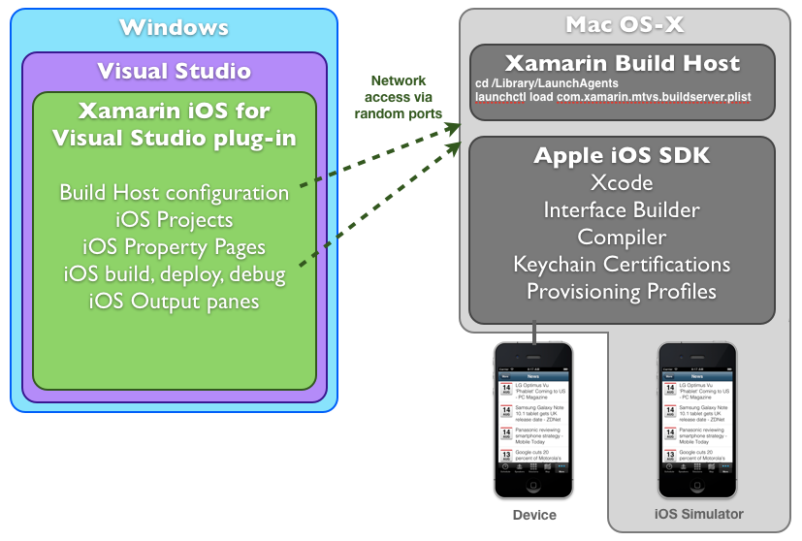
Develop in Visual Studio

Slide 16
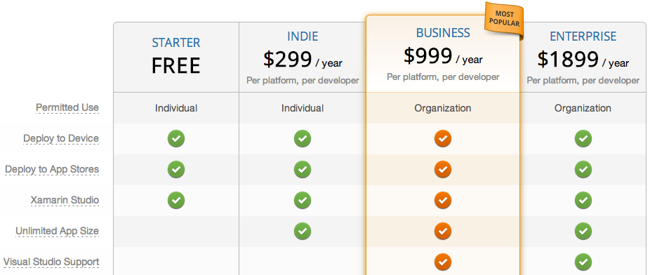
Pricing

Slide 17
Future…
Universal apps – Available in VS 2013
New code sharing method
Coming soon to Xamarin Studio
Better iOS support in VS?
Part of Microsoft?

Slide 18
Demo…

Slide 19
iOS – Project files
Resources – Images etc. copied to app
AppDelegate.cs – Application level events
*ViewController.cs – Startup screen
Info.plist – Manifest file for settings
MainStoryboard.storyboard – Default storyboard definition

Slide 20
Android – Project files
Properties/AndroidManifest.xml: Standard declarations such as application name etc.
Resources: Images, layouts, strings etc.
/drawable: Images used by system
/layout: *.axml (Android XML) UI files
/values: Key-value pairs for strings. Used for localization etc.
MainActivity.cs: MainLauncher action and the first activity

Slide 21
Demo project
Consuming Web API from Android and iOS
Portable Class Library
Displaying list of Football games in table view
Powered by dagensfotboll.se™

Slide 22
Demo!

Slide 23
Further reading…
www.xamarin.com
Book: Xamarin Cross-platform Application Development by Jonathan Peppers
Building Cross-platform Applications: tinyurl.com/pdmm6aw
Miguel@build: tinyurl.com/p369gw7
Hanselman@teched: tinyurl.com/ndxsjzt
Exempel och presentation: https://github.com/stratiteq

